Slide 1
4.3 Training Our Model
Notes:
Now we have data, let’s build a model and train it to predict steering angles.

Slide 2
Training our model
Creating training, validation and test datasets
Keras CNN definition
Loss functions
Debugging hints and tips
Analysing training performance

Slide 3
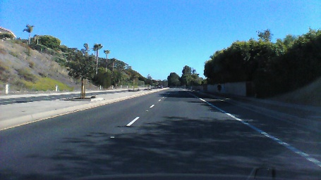
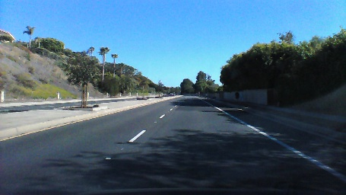
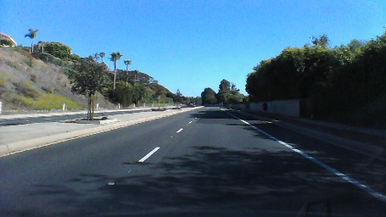
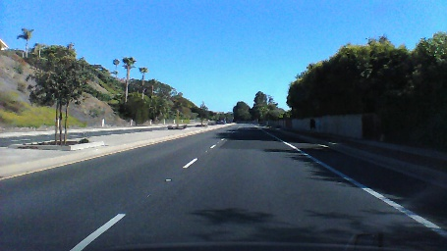
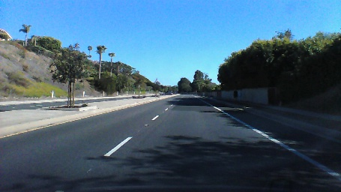
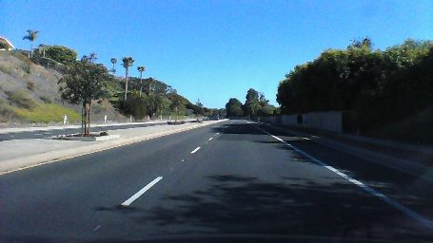
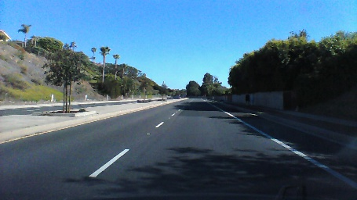
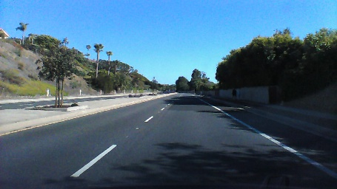
Splitting our data into train, validate and test datasets
Data set | Frames
Training | 0, 2, 4, 6, 8, 10, 12, …
Validation | 1, 5, 9, …
Test | 3, 7, 11, …
Notes:
We split the data into training, validation and testing to help train the model and understand how it predicts previously unseen examples.
During a typical training exercise, training data is used to train the model, then validation data is used to understand how well it predicts after that epoch. For example, if I train on 128 images, I would then validate how accurate the prediction was on another 128 samples.
Once the model is fully trained, you would test it on the final 20% to see how accurate it is.
This is one option of splitting the data, another way could be to take the first 60% as training data, the next 20% as validation, and the final 20% as test data.

Slide 4
Pre-processing the image
We resize and crop the image, focusing on the road as this is the region of interest for predicting steering angles.
Resizing reduces the amount of processing for each image

Slide 5
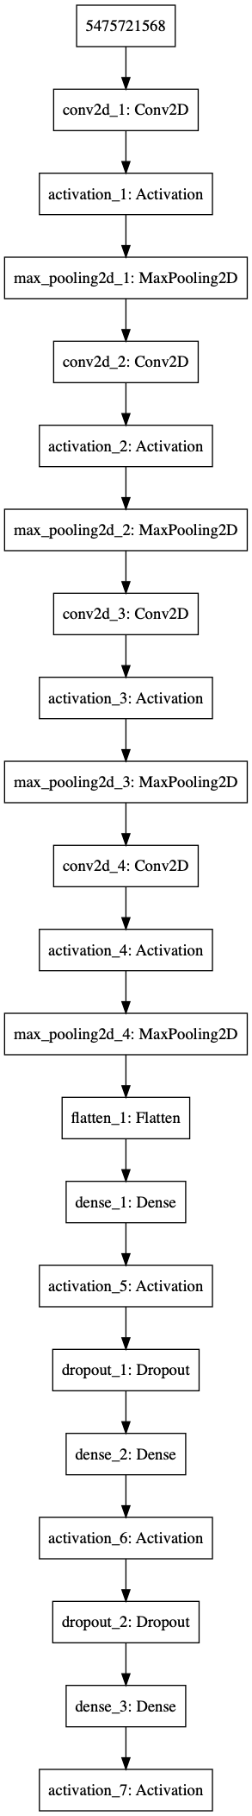
Our CNN
Angle
Notes:
Our CNN is built up of a 5 convolutional layers followed by 3 fully connected layers. Dropout is used to improve training performance by effectively dropping connections between artificial neurons. It makes those that remain more resilient to the underlying data.
The image of the CNN architecture is created by Keras, and you can analyse it in more detail by looking at the code, which we’ll do next, and by looking at the original image in the logs directory for this section.

Slide 6
Let’s explore the code…
Notes:
Look at the model, generators, and the training code. Generators and the training code are similar to section 3.

Slide 7
Debugging Neural Networks
Training neural networks can be more trial-and-error than science
Prove the code works by running a small number of samples and a single batch
Train using a small number of samples to check that the model converges and you see overfitting
Increase the number of samples over time
Make changes to the network architecture, hyper-parameters, etc. to find an optimal solution
Then scale to the full dataset
See https://keras.io/getting-started/faq/#why-is-the-training-loss-much-higher-than-the-testing-loss
Notes:
This is the approach I use for training neural networks. Typically I would perform the initial training and tuning locally to ensure the code is working and the model is starting to converge or a small number samples before moving to a cloud based server to train on the full dataset.
Also, Keras disables drop-out on validation so you will notice that the validation loss is often lower than the training loss. This is OK if you have dropout in the network, but if you don’t and you see this, then you have issues relating to your data (for example you need to think about the split between train and validation more, such as validation may be skewed to a smaller set of examples than the training data)

Slide 8
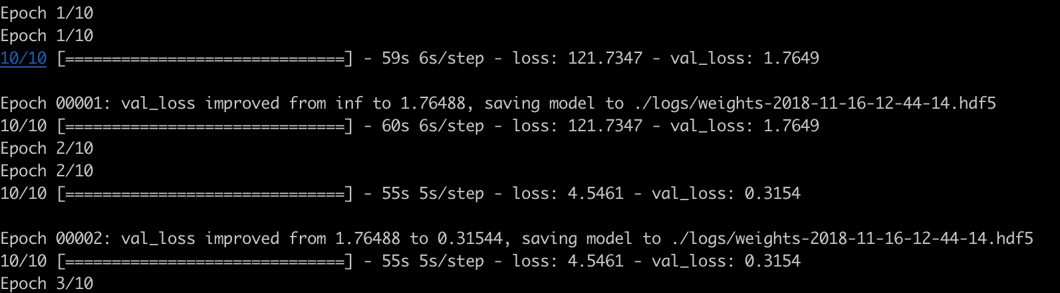
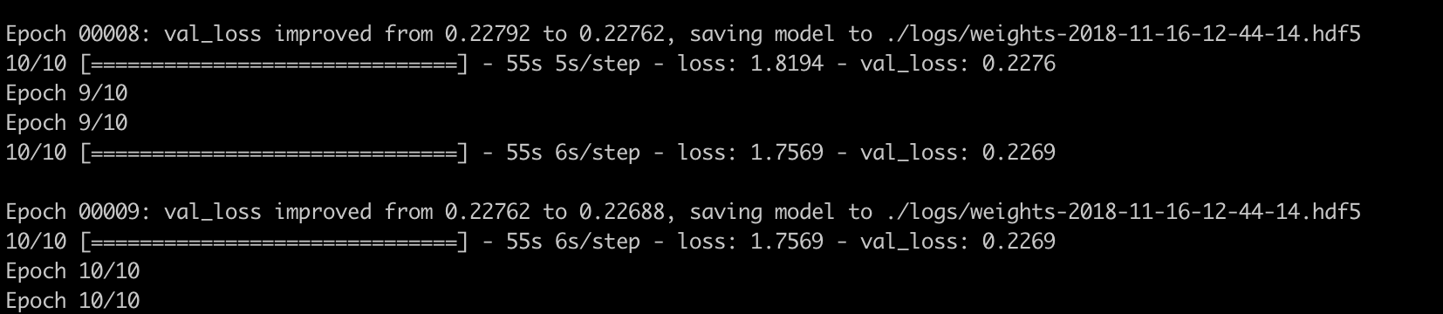


Analysing Training Performance
We are looking for the [training] loss and validation loss to decrease over time
python3 train.py -epochs 10 -limit-batches 10 -debug Y
python3 train.py –epochs 200 # Train on the full dataset
Notes:
Here’s an example of training and validation losses converging from training our convolutional neural network. I’ve shown this with just 10 batches and training for 10 epochs (or 10 iterations through those 10 batches).
To train on the full dataset, I ran training for 200 epochs.

Slide 9
Inferring Steering Angles
Notes:
In the next video we’ll use our model to infer steering angles and to create a video for demo purposes

